Slide 1










Registered EV’s in the State of Washington
GitHub URL: https://github.com/kperello/bus5100-93
Kevin Perello
Kjarsten Philipsen
Jacquelyn Pruitt
Michelle Rivas
Joel Brambila
Aaron Castaneda
Marcela Espinoza
Team 5: The Golden Eagle Analysts
Notes:
Joel

Slide 2
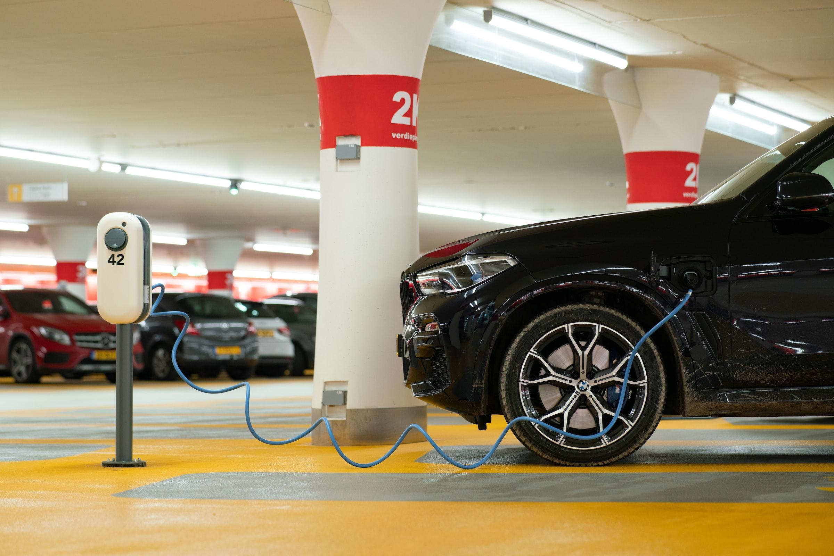
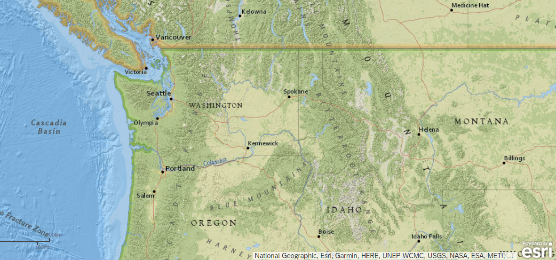
Overview
WHO/WHAT: Registered EV’s in WA from 2008 - 2022
WHEN: Data pulled from Data.gov (29MB-Data Size)on 02/17/23
GOAL: Find the following - EV Manufacturer Share, Models, and Owner Locations
Notes:
Jackie
We chose to analyze the dataset from Better Electric Vehicles (BEVs) and Plug-in Hybrid Electric Vehicles (PHEVs) that are currently registered through Washington State Department of Licensing (DOL)
Our data was taken from Kaggle
We analyzed vehicle model years from 2008 to 2022 as of February 17, 2023 in WA

Slide 3
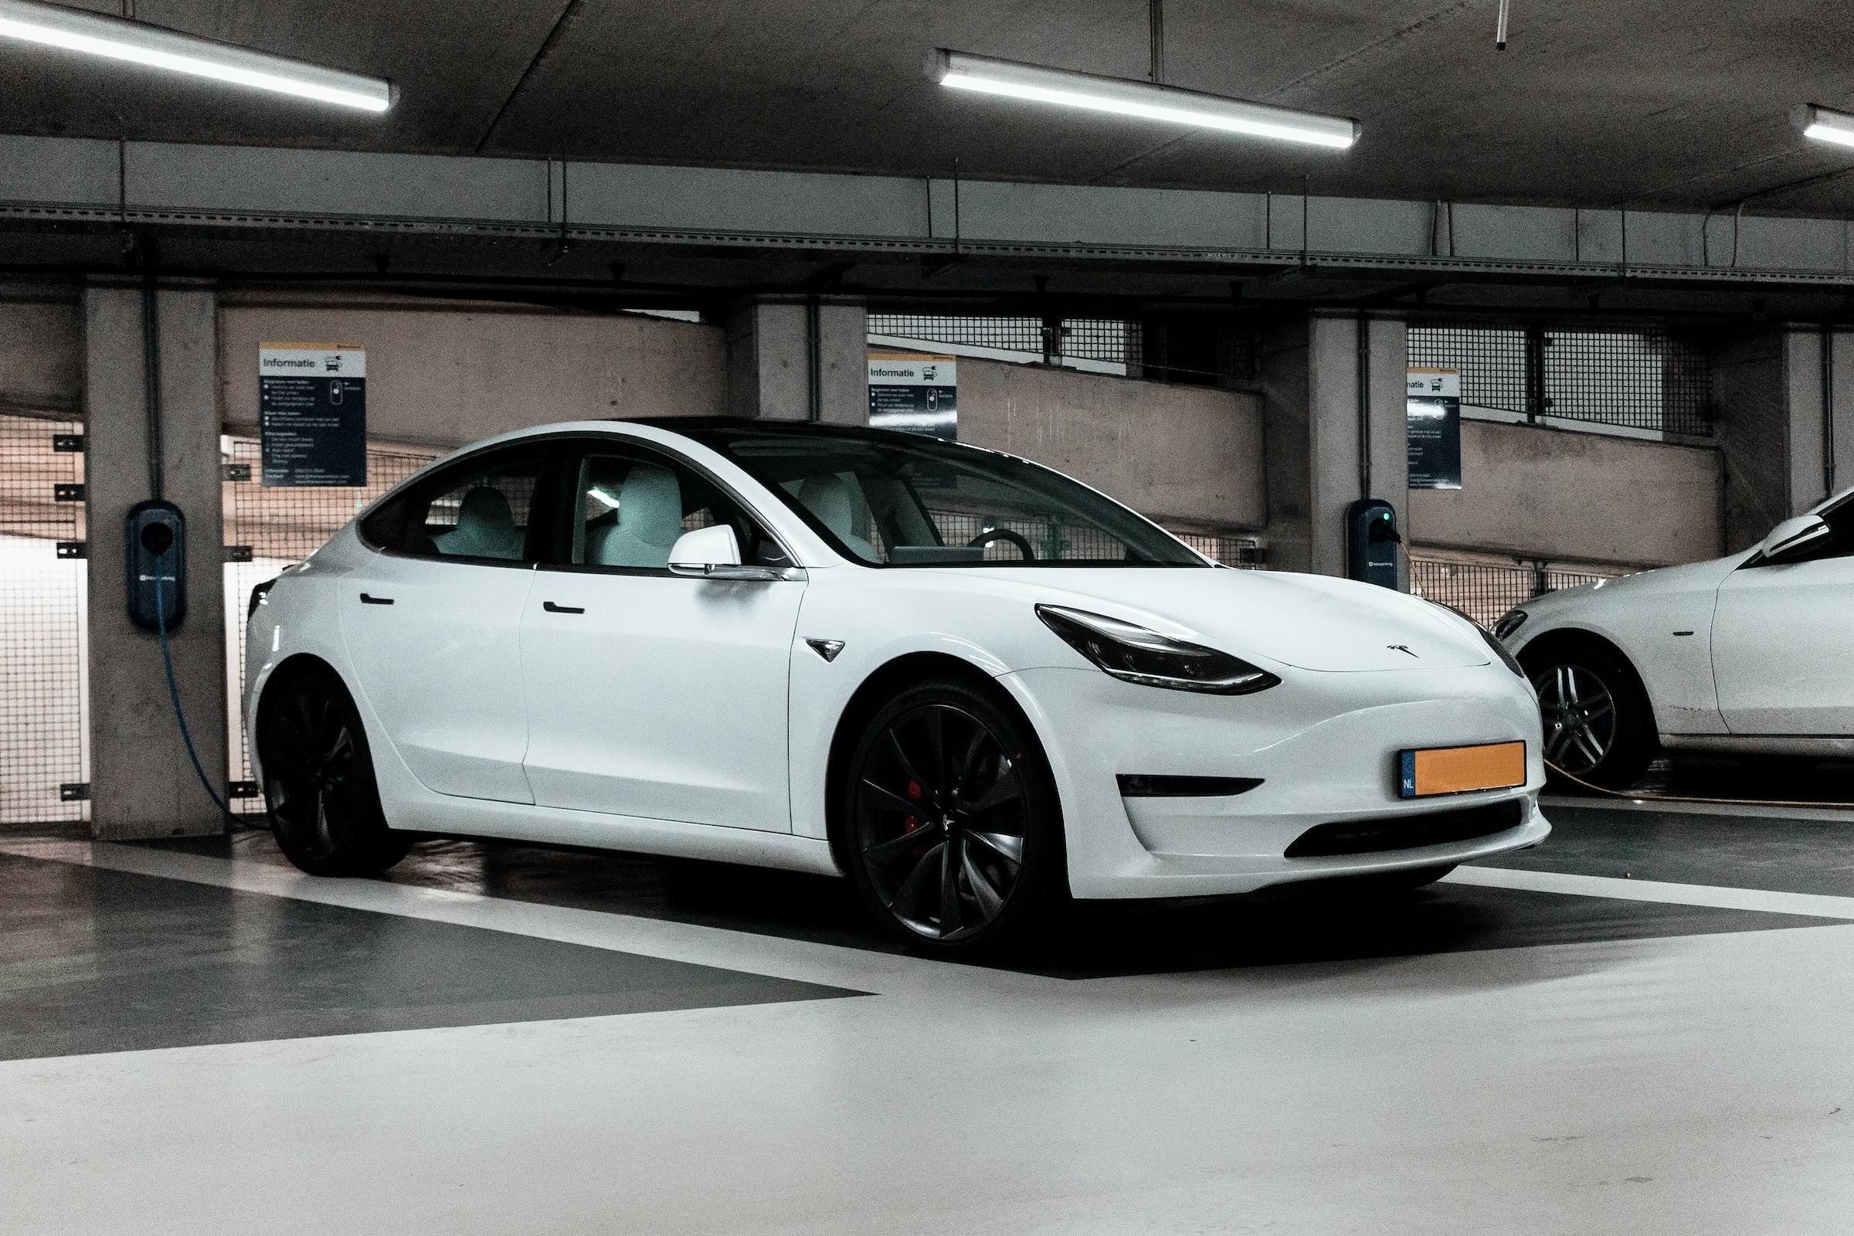
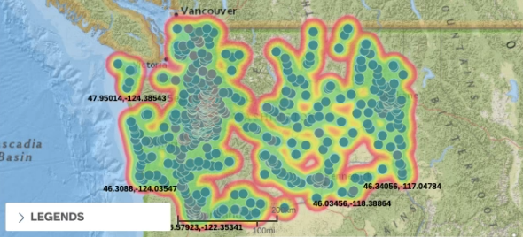
Heat Map - Density of EV’s in WA
Lab 1: Geo-Map
Notes:
Michelle
This lab displays the population density of EV’s in Washington
Washington State is a leader in EV ownership
According to evadoption.com, there are 3,765 public charging ports in Washington State, with 80 Level 1, 2,985 Level 2, and 700 Level 3 (DC Fast Chargers)

Slide 4
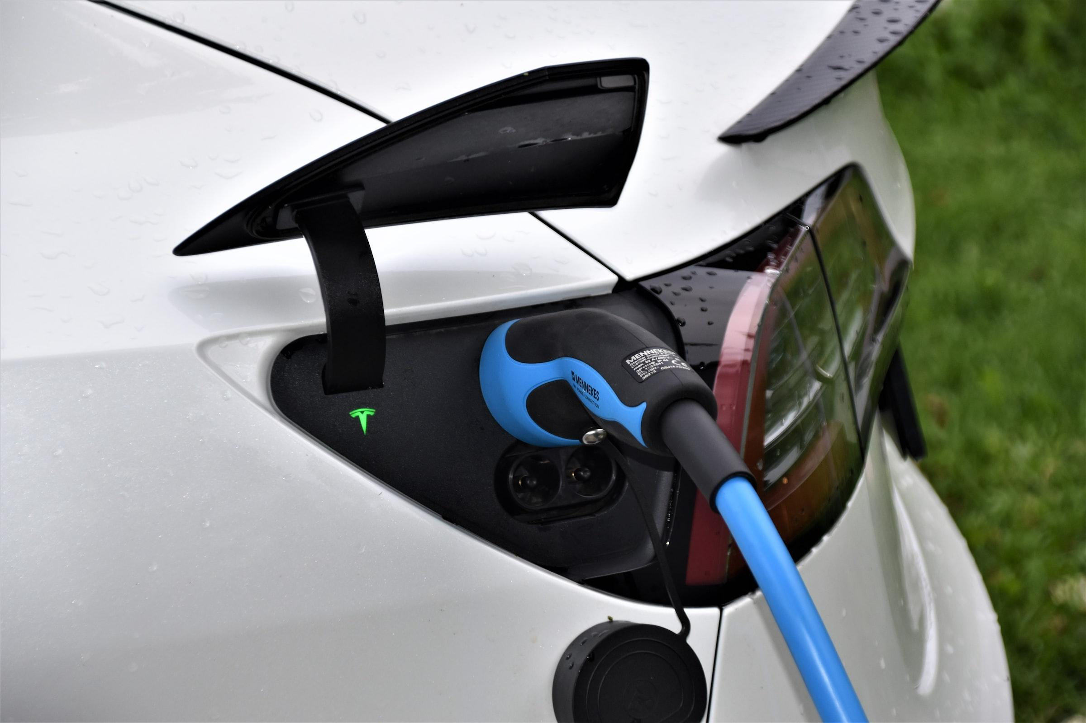
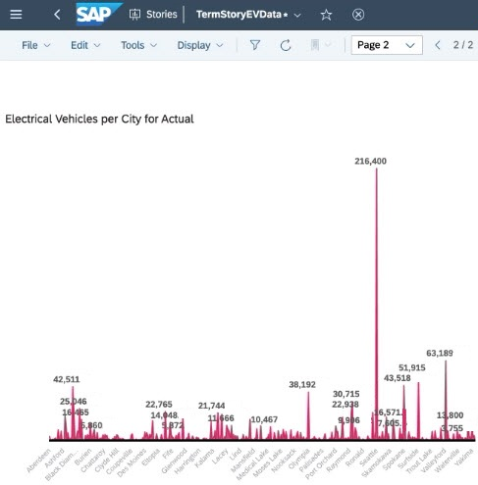
Electric Vehicles per City
Major cities with highest EV population:
Seattle
Valleyford
Surfside
Fact: Electric Vehicle Federal Tax Credit up to $7,500
Lab 5: Trend Chart
Notes:
Marcela
Most registered EV’s were discovered in cities such as Seattle, Valleyford, and Surfside
According to Electrek, Washington has relatively clean and cheap electricity as compared to almost every state, given the state's high hydropower mix.
It also has relatively high gas prices and more public chargers than most states, making the state an ideal place to own an electric car.
Hence why they have nice tax credit incentives
Inc comparison to rebate amounts in CA are up to $4,500 for Fuel Cell electric vehicles, $2,000 for regula EVs, $1,000 for Plug in hybrids, and $750 for zero emission motorcycles

Slide 5
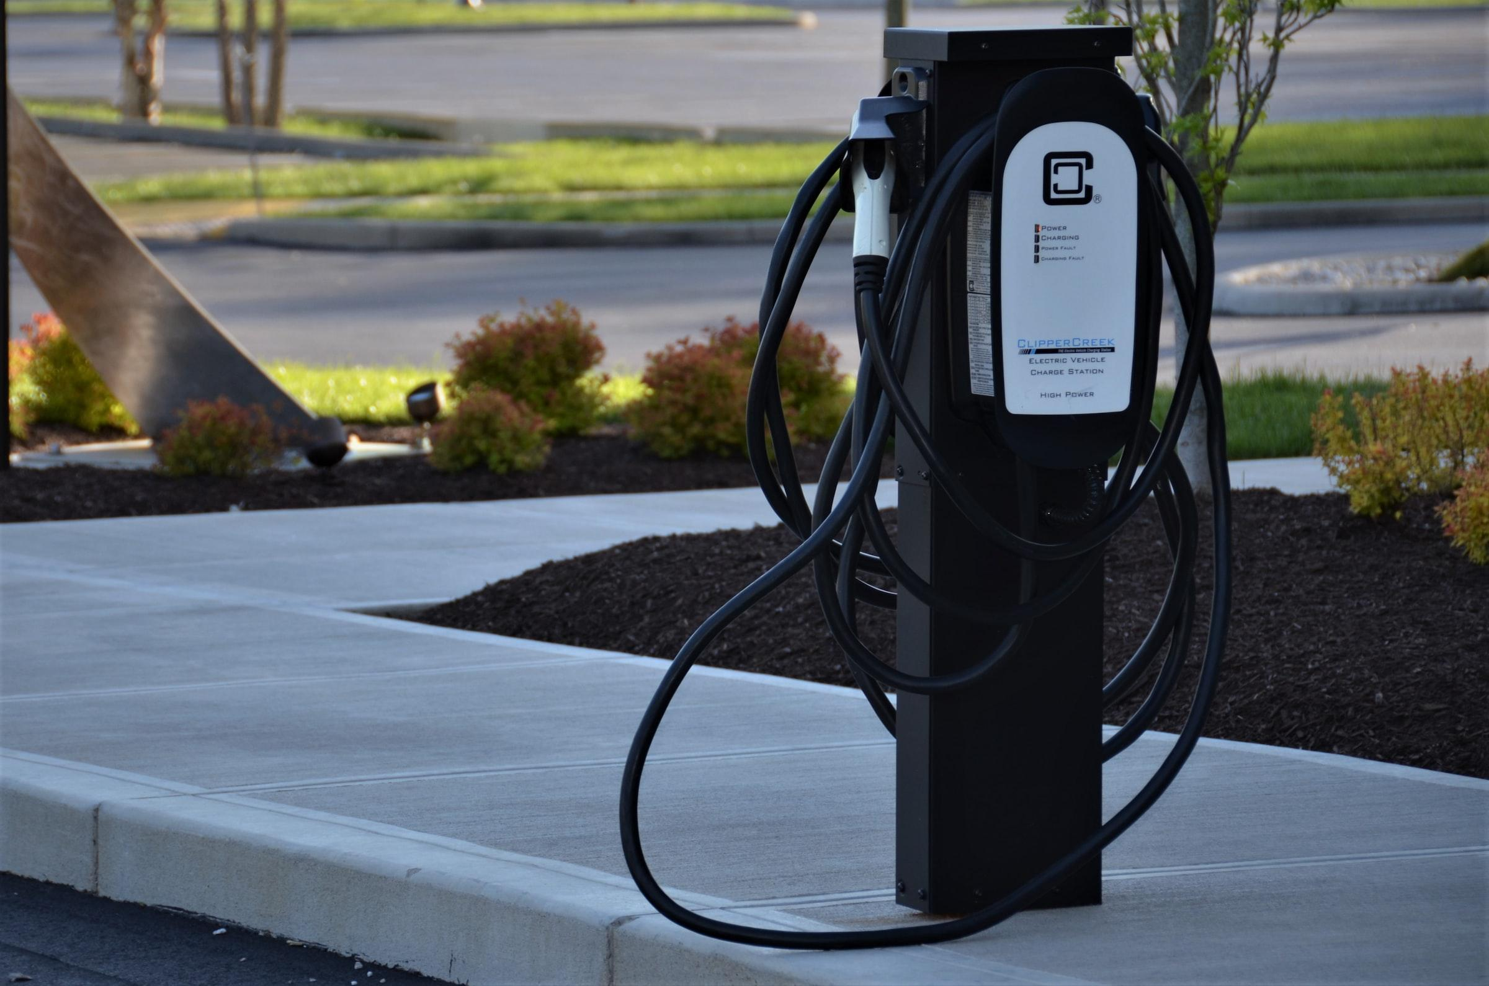
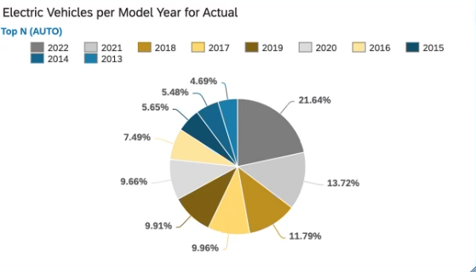
Registered EV’s per Model Year in WA
Greatest % of EV by Model Year
2022 - 21.64%
2021 - 13.72%
2018 - 11.79%
Lab 4: Pie Chart
Notes:
Kjarsten
The EV market has experienced tremendous growth over the past couple of years and we can see that Tesla is the leading manufacturer
Several attributes differentiate Tesla from other manufacturers (build, capacity, intelligence, etc.)
Innovation

Slide 6
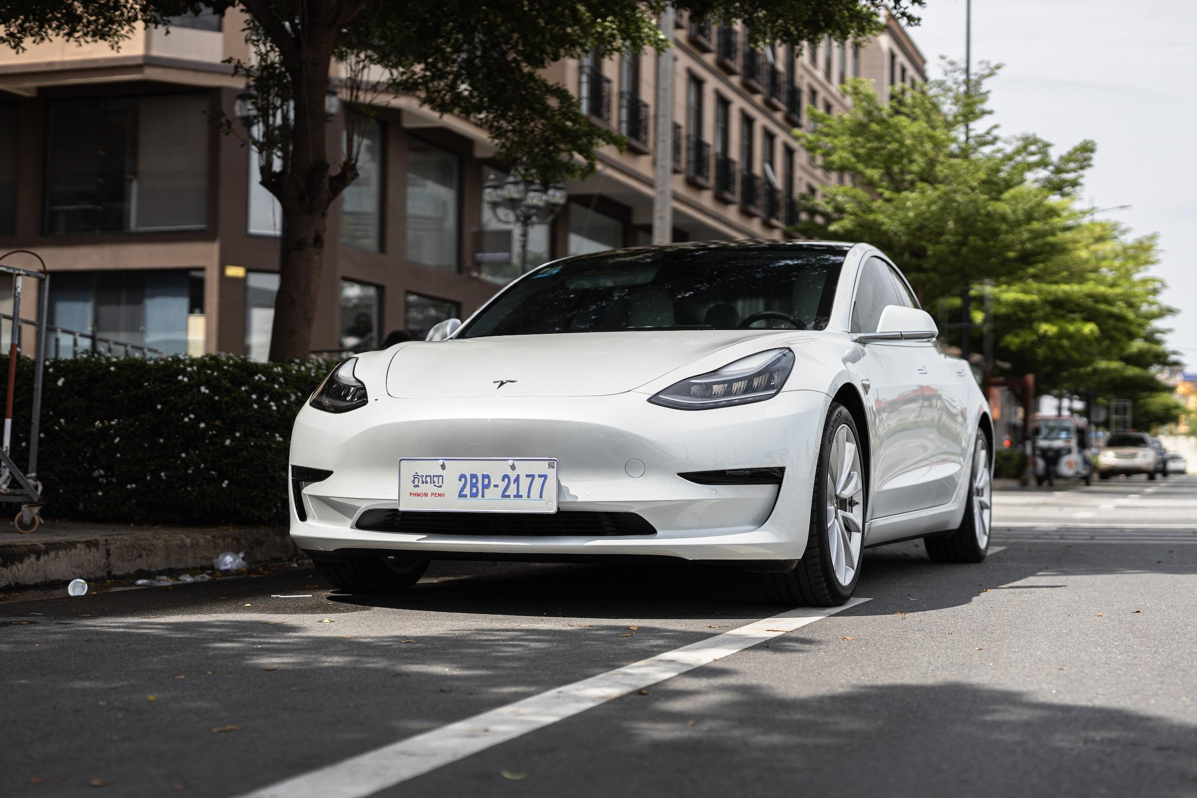
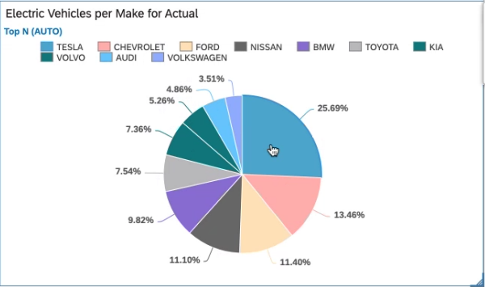
EV’s per Make in WA
Distribution of Vehicles per Make in WA
Tesla - 25.69%
Chevrolet - 13.46%
Ford - 11.40%
Lab 4: Pie Chart
Notes:
Aaron
Most Tesla Model 3 owners are in CA but WA comes at second place with having up to 30,000 registered
Costs about $42,000 / more affordable than other models making it more attainable
The EV market has experienced tremendous growth over the past couple of years and we can see that Tesla is the leading manufacturer
Several attributes differentiate Tesla from other manufacturers (build, capacity, intelligence, etc.)
Innovation

Slide 7
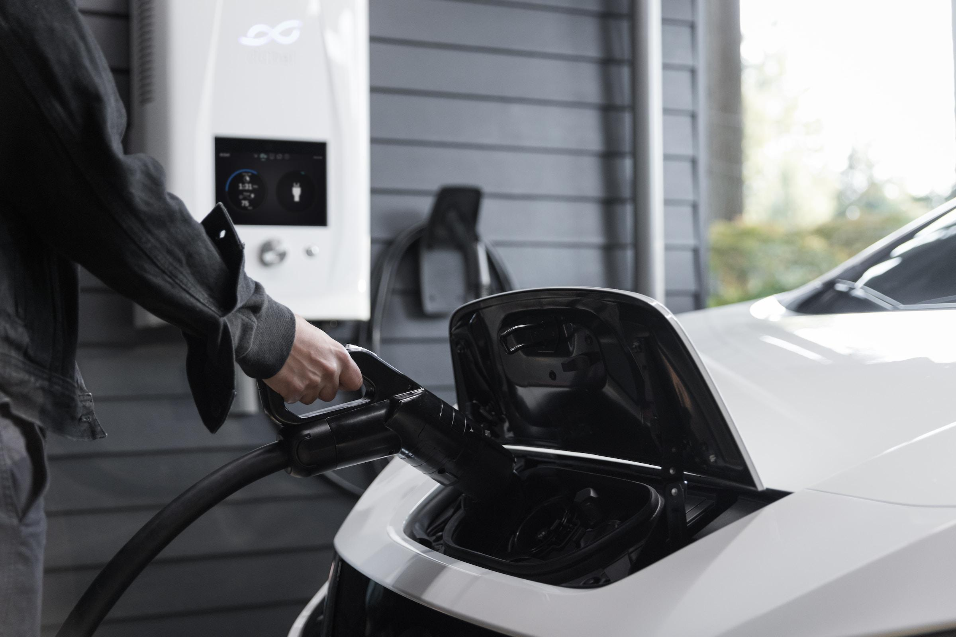
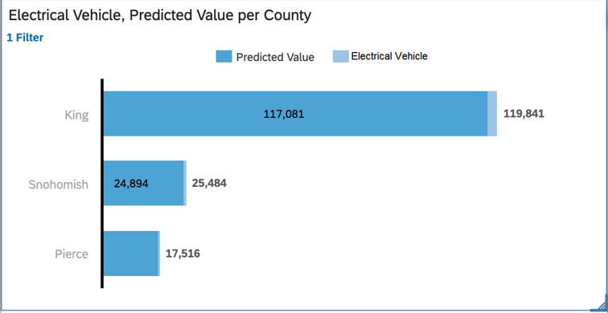
EV Predicted Value per County
EV’s Predicted Value
(by County)
King County being most populous
Snohomish highly accurate
Pierce County close third

Slide 8
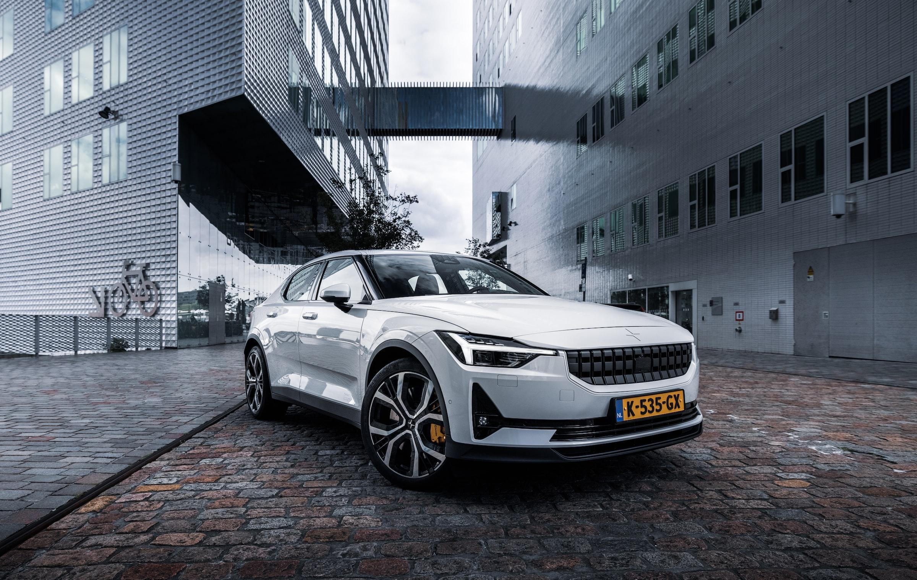
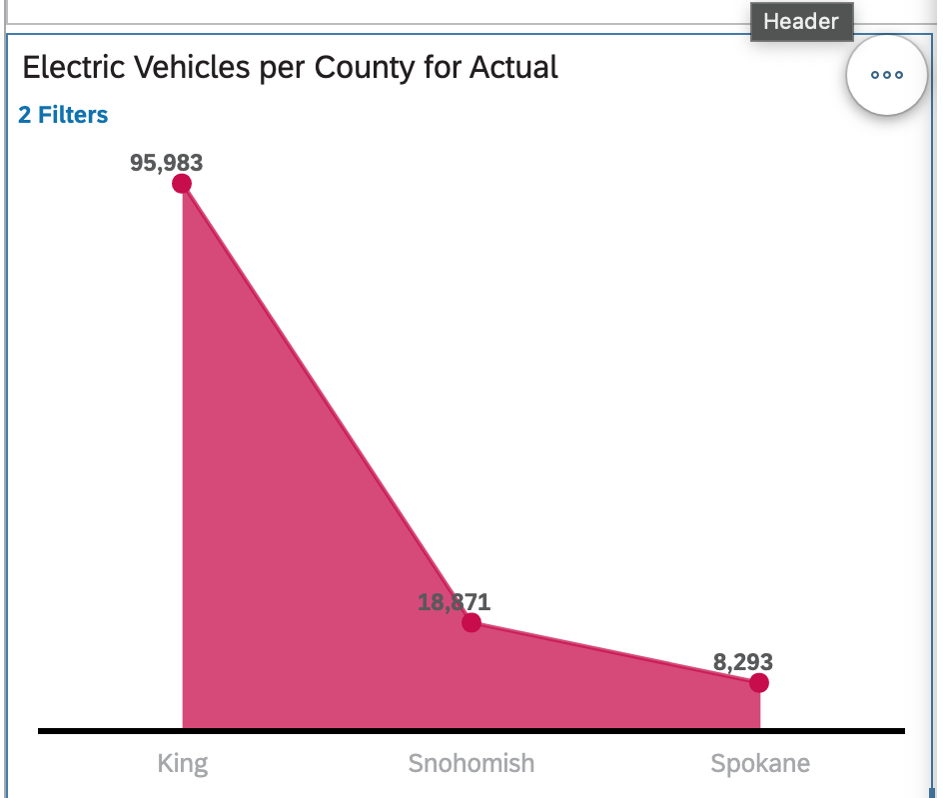
Conclusion
Counties with the highest population of EV’s
1st Place: King
Coming in 2nd: Snohomish
3rd Place: Spokane
Key Takeaway: Metropolitan areas have the highest amount of EV’s

Slide 9
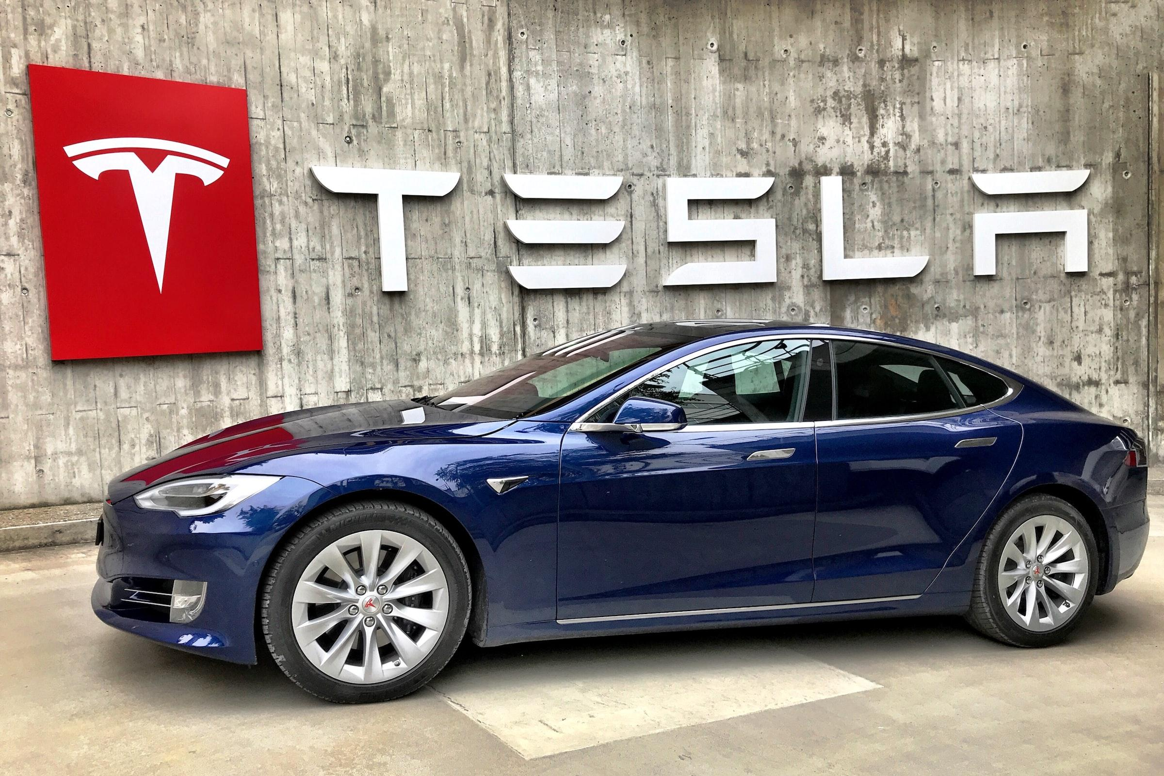
THANK YOU
Notes:
Closing: go EV
Clean the air for the youth
Drive in the carpool lane
Get a tax credit

